Slide 1
Machine Learning In PRACTICE - Introduction
Przemysław Sekuła

Slide 2
One-HOT encoding (1/3)
One hot encoding is a technique used for categorical data.
Imagine you have a categorical data such as Work Class (Private, Self-employed, Government, Other). But your algorithm can process only numbers.
One solution (usually bad one) is to assign the numbers to the categories:
Why it is wrong: There are no linear relations among the categories
WorkClass | Nr
Private | 1
Self-employed | 2
Government | 3
Other | 4
Person | WorkClass
John Smith | Private
Antony Joshua | Self-employed
Michael Jordan | Private
Justin Biber | Private
Hanna Montana | Other
Mata Hari | Government
Person | WorkClassNr
John Smith | 1
Antony Joshua | 2
Michael Jordan | 1
Justin Biber | 1
Hanna Montana | 4
Mata Hari | 3

Slide 3
One-HOT encoding (2/3)
Person | WorkClass
John Smith | Private
Antony Joshua | Self-employed
Michael Jordan | Private
Justin Biber | Private
Hanna Montana | Other
Mata Hari | Government
Better solution: use one-hot encoding
Person | Private | Self-Employed | Government | Other
John Smith | 1 | 0 | 0 | 0
Antony Joshua | 0 | 1 | 0 | 0
Michael Jordan | 1 | 0 | 0 | 0
Justin Biber | 1 | 0 | 0 | 0
Hanna Montana | 0 | 0 | 0 | 1
Mata Hari | 0 | 0 | 1 | 0

Slide 4
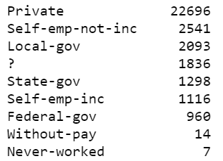
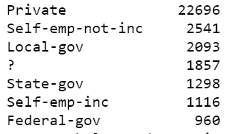
One-HOT encoding (3/3)
Be careful with rare classes!
Example: Solution: Aggregate Rare Classes

Slide 5
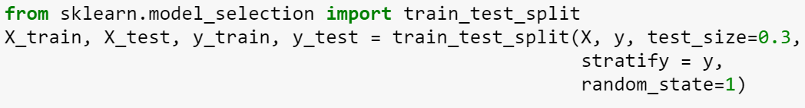
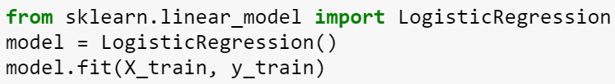
Python code
To split the data into train / test dataset:
To do one-hot encoding
To train your model

Slide 6
Thank you Q & A

